Slide 1
Deep Learning Approach to Diabetic Retinopathy Detection
Course: Computer Vison (2160431401)
Student: Van-BINH Duong

Slide 2
Table of contents
Introduction
Problem statement
Method
Results
Conclusion

Slide 3
Introduction
Diabetic retinopathy, a severe complication of diabetes, poses a significant risk of permanent blindness if left untreated.
Early detection is paramount for successful treatment, yet accurate identification of its stages remains challenging, relying heavily on expert human interpretation of fundus images.
Purpose of the presentation: Introducing an innovative automatic deep-learning-based method for the stage detection of diabetic retinopathy using a single fundus photography.

Slide 4
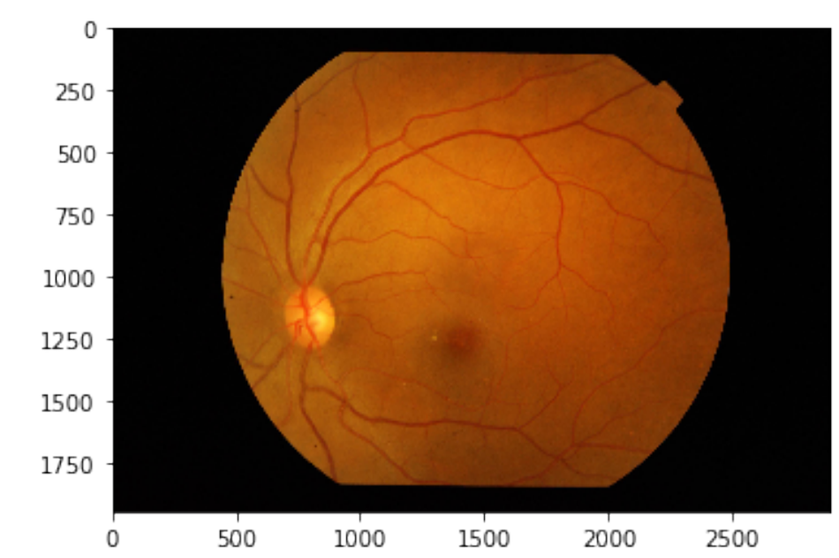


Problem statement
Detection result
No Diabetic Retinopathy (DR)
A fundus photography
Computer vison model
Mild
Moderate
Severe
Proliferative DR

Slide 5
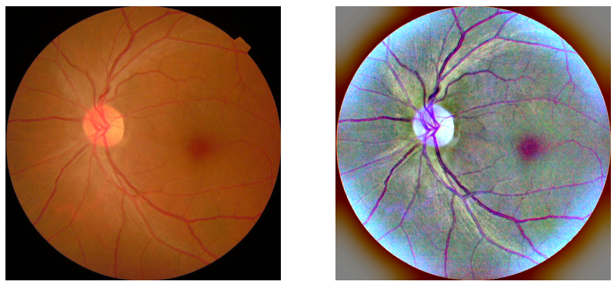
Method Data augmentation
Datasets:
APTOS 2019 Blindness Detection Dataset
The following augmentations are applied to images before training:
horizontal flip, scale
a shift of RGB values
additive Gaussian noise
circle crop
Original image
Augmented image

Slide 6
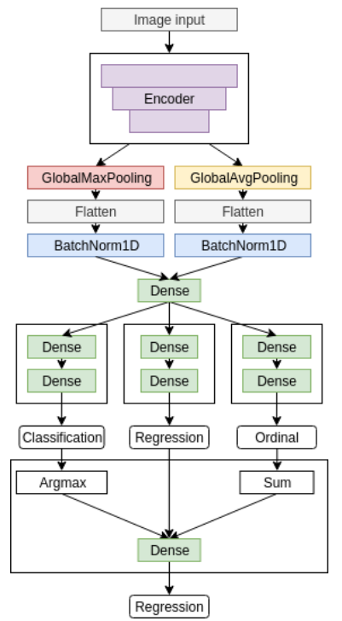
Method Network architecture
The CNN multi-task learning approach with 3 encoders is proposed to detect diabetic retinopathy.
Each encoder is trained to solve its task based on features extracted with CNN backbone:
classification head
regression head
ordinal regression head

Slide 7
Method Pre-training process – Transfer learning
The natural features of the diabetic retinopathy are consistent between different people and do not depend on the dataset -> transfer learning is possible.
Data for transfer learning model:
APTOS 2015 Blindness Detection Dataset
Model initialization:
feature extractor with weights from Imagenet-pretrained CNN.
heads are initialized with random weights.
Training:
Epoch: 20
Optimizer: minibatch-SGD
cosine-annealing learning rate schedule

Slide 8
Method Main training
Data:
APTOS 2019 Blindness Detection Dataset
Model initialization
weights obtain in the pre-training stage
Focal lost for classification and ordinal head
Mean-squared error for the regression head
Training
Epoch: 75
Optimizer: rectified Adam
cosine-annealing learning rate schedule

Slide 9
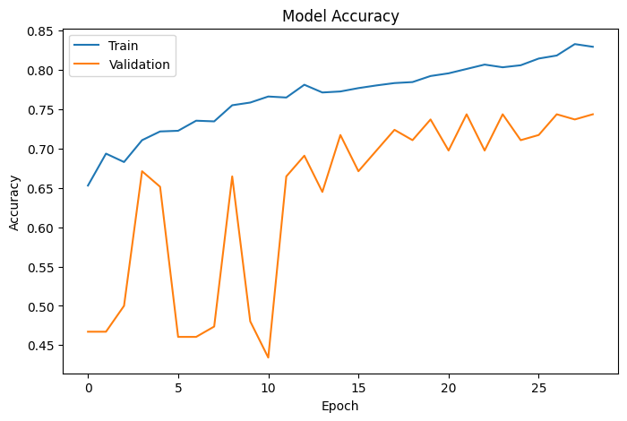
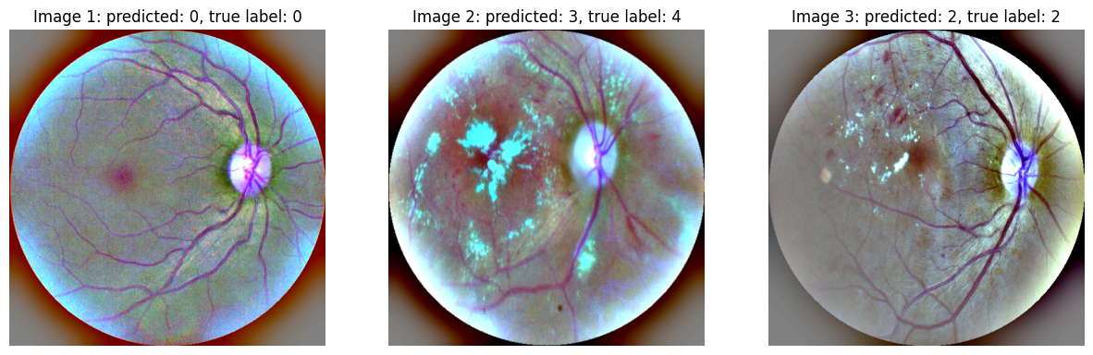
Results

Slide 10
Conclusion
Proposal of using
multistage transfer learning approach
an automatic method
for detection of the stage of diabetic retinopathy by single photography of the human fundus.
Best augmentations:
horizontal flip, scale
a shift of RGB values
additive Gaussian noise
circle crop

